Slide 1
Coding with Minecraft: Introduction

Slide 2
Lesson A: Minecraft &
Makecode

Slide 3
What we’ll learn
The importance of computer science and coding
How to play Minecraft: Education Edition
Block programming in Microsoft MakeCode
Change our Minecraft world through coding

Slide 4
Computer Science
What is it?
Why is it important?
The study of what machines can do for us.
It’s changing everything about the way we communicate, live, and work, so it’s important for everyone.
Teaches important skills, like creativity, problem solving, critical and flexible thinking, working with others.
Helps us get and keep successful jobs and careers.

Slide 5
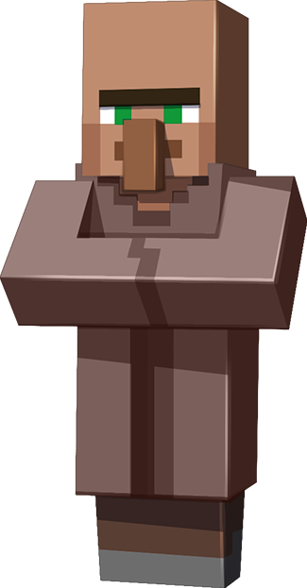


What is Minecraft?
A game about placing blocks and going on adventures
Build anything you can imagine
Go on grand expeditions
Let’s explore!

Slide 6
Your turn to play
Use keyboard and mouse controls
Look and move around
Play with your inventory
Build and mine

Slide 7
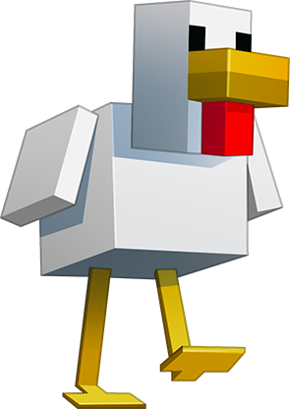
Let’s discuss
How do you use your mouse so your player can look around?
What are two keyboard controls to move your player?
How do you open the chat command field in Minecraft?
Do you like using mouse or keyboard controls better?
What’s one thing you discovered while playing?

Slide 8

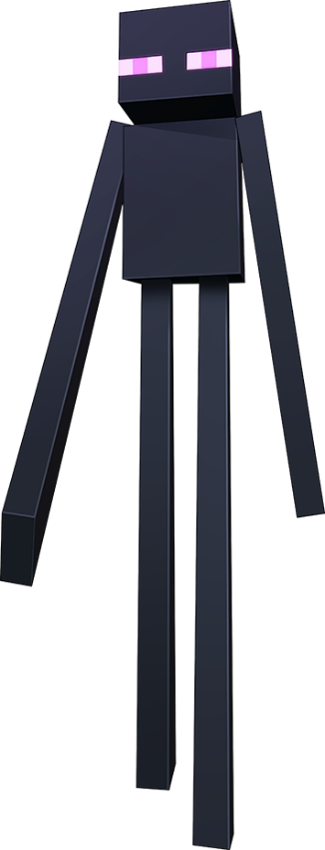
Let’s talk coding
What is coding?
A set of instructions that tells a computer to do something.
What do you do with computers?
What else can computers do?
How do your parents use computers?

Slide 9
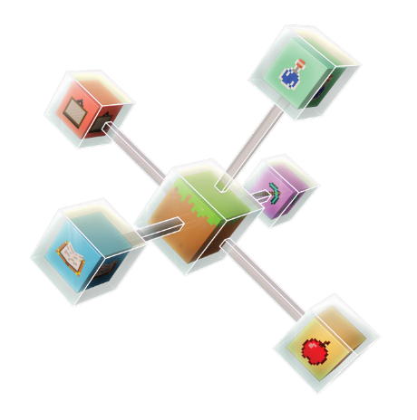
A coding mindset
Learning something new can be hard
Be curious if you get frustrated
Be persistent and keep trying
After you try to figure it out, ask others for help
Learn from mistakes

Slide 10
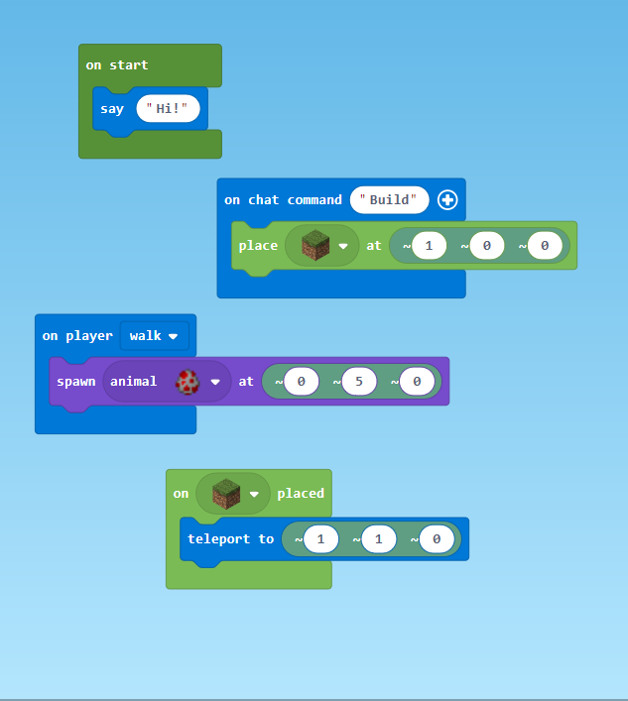
Coding with Microsoft Makecode
Part of the Code Connection app
Code in blocks or JavaScript
Let’s try it out!
Notes:
say: Today, we’re using Microsoft MakeCode to give instructions to the computer to change your Minecraft world.
It’s part of an app called Code Connection.
MakeCode lets you program with blocks or what’s called JavaScript. We’re going to use blocks, which are kind of like coding with puzzle pieces like you see on the screen. It’s an easier way to learn to code.
Like humans use different languages to talk to each other in English, French, Spanish, or other languages, computers use special languages too – a programming language is a special type of language that computers understand.
JavaScript is a text-based language, using letters, numbers, and symbols, and it’s one of the most popular programming languages in the world. It’s used on most of the websites that you visit.
As you keep learning to code and move to JavaScript, you can keep using MakeCode.
Do: Select Enter for the on-click animation and explain:
Let’s do our first coding activity to see how it works. First, we want the MakeCode and Minecraft windows side by side on our screens. Your Surface should have Minecraft at full screen right now. To set it beside MakeCode, press the Windows and > keys on your keyboard. The Windows key looks like a waffle between FN and Alt keys. The > key is below the right Shift key.
Activity: Chicken Rain tutorial (approximately 5 minutes)
Do: Orient participants to MakeCode and complete the tutorial onscreen, with participants following along on their devices:
Toggle to Microsoft MakeCode and set it side by side with Minecraft onscreen.
Under Tutorials, select Chicken Rain, then OK.
Before continuing the tutorial, explain the layout:
Coding Workspace – Where you work with different coding blocks.
Tool box – Where you find different types of code blocks.
Tool drawer – When you select a drawer it opens to show the available coding blocks. Point out that the coding block in each drawer are color coded for those types of blocks.
Point out the home screen button , and the button to switch between block and JavaScript coding but reinforce that we’re using block coding through the camp.
Select Next to start the tutorial and complete the seven steps, as the participants follow along on their devices. Be sure to check that all participants have completed each step before moving on to the next step.
NOTE: To close the chat command field in Minecraft, select Exit at the top left of the screen or hit Esc on the keyboard. This allows you to move the player around to see all the chickens.
At step 7, reinforce that they just completed a Mod, which just means that they changed their Minecraft world through coding.
Then select Finish to exit the tutorial. This transfers the coding blocks to the main coding Workspace.
Toggle back to the presentation onscreen.

Slide 11
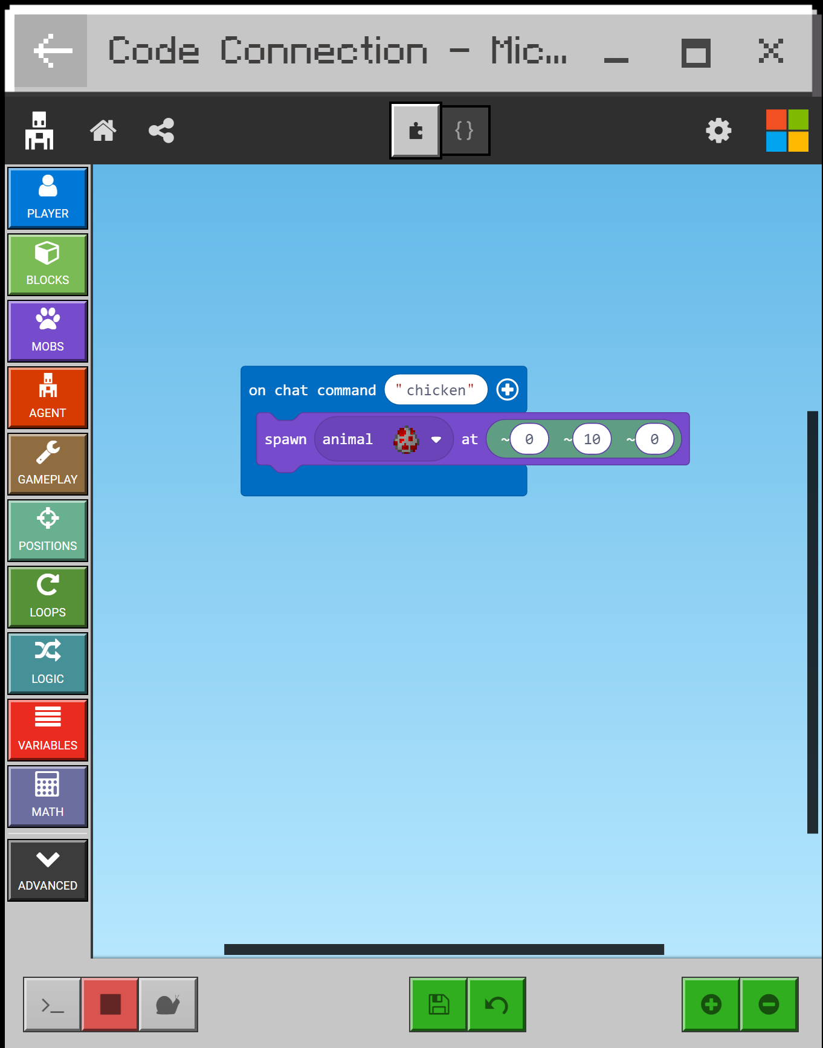
Your turn to code
Make it rain something else
Change the position the “rain” falls
Try something else
Select the home button to try a new tutorial from the first row

Slide 12
Let’s discuss
What’s an ?
How do you get to the coding Workspace?
How do you add a block to the coding Workspace?
Who wants to share their work?
on chat command

Slide 13
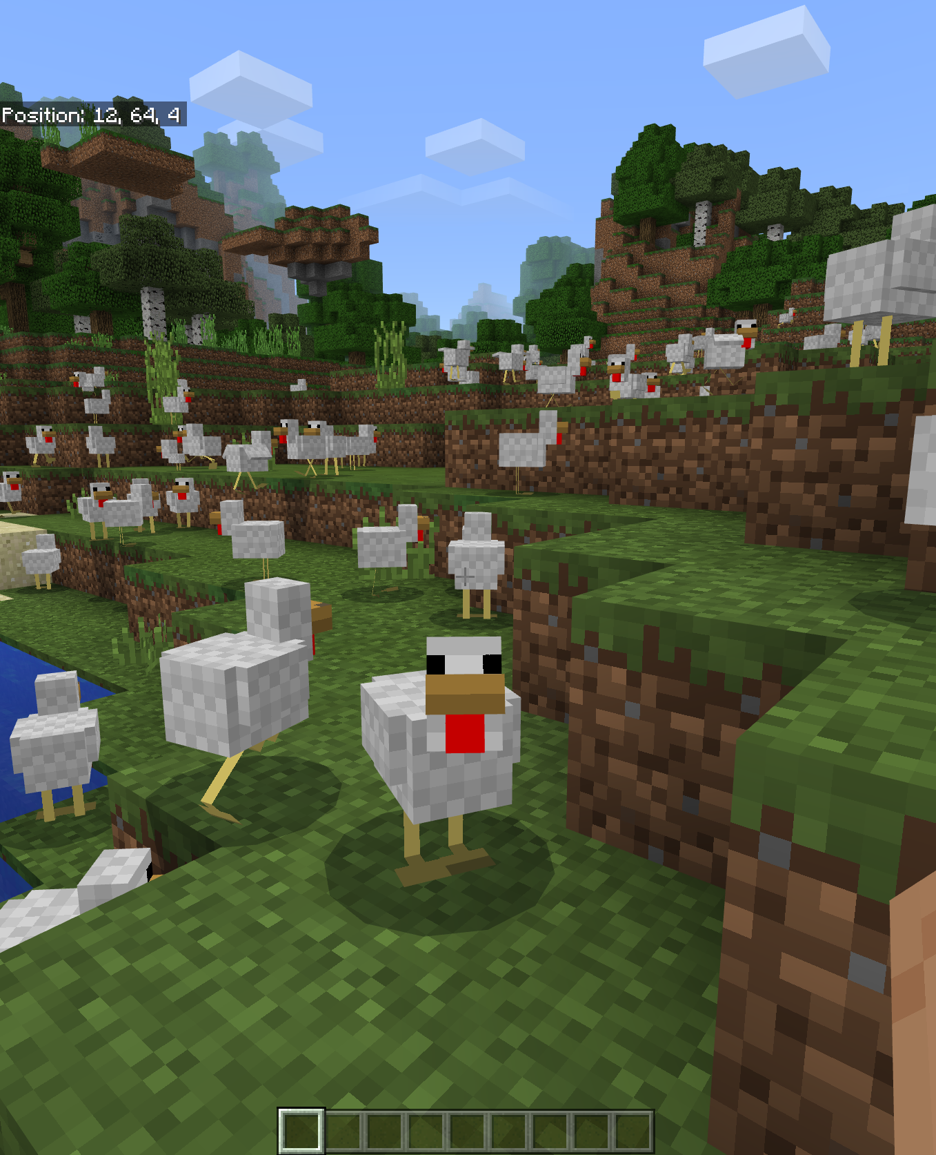
What we learned today
The importance of computer science and coding
How to play Minecraft: Education Edition
Block programming in Microsoft MakeCode
Made it rain hundreds of chickens through coding

Slide 14
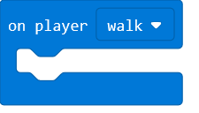
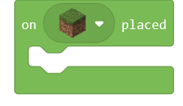
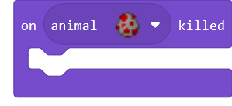
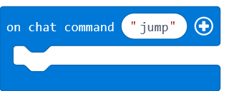
Next time
Learn about events and event handlers
Code with event handler blocks
Design your own coding project!

